Slide 1
All Saints Church, Beighton
Repair
Restoration
Development
Photo courtesy Mike Page

Slide 2
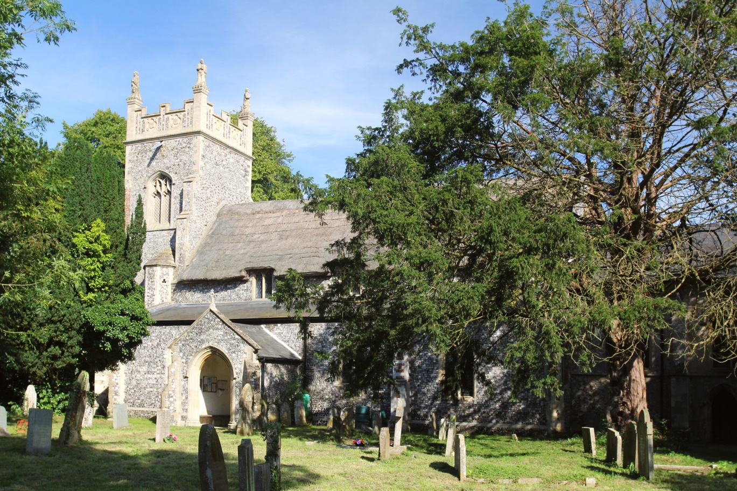
All Saints Church, Beighton
The Church building:
An important medium sized mainly 14th century building mostly of flint with limestone dressing
The original nave roof structure of 28 scissor braced collar trusses supports a thatched roof with eyebrow clerestory windows
The upper tower remodelled in the 18th century
Much restoration in the 19th century, including the complete rebuilding of the North aisle
1890 work to tower adds the current stepped parapet and the four Evangelists at the corners

Slide 3
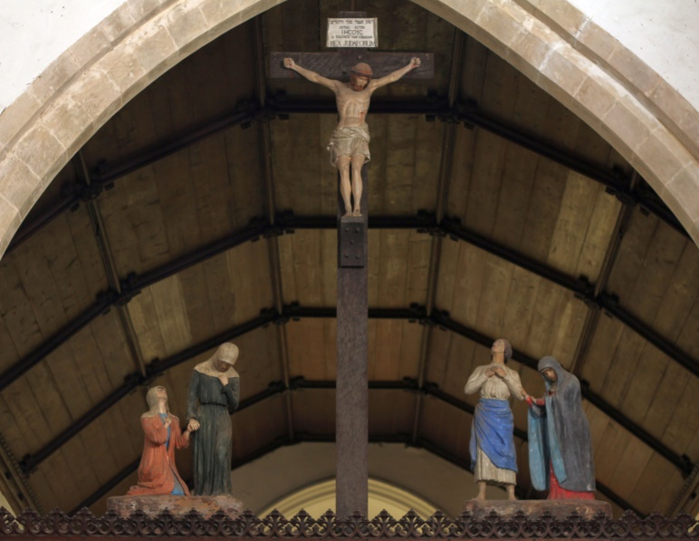
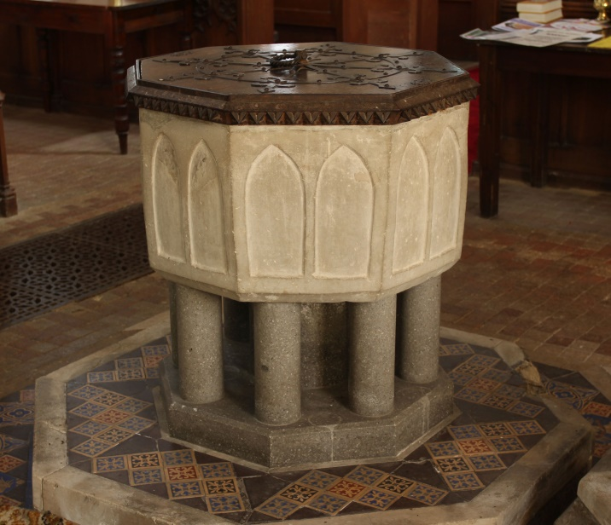
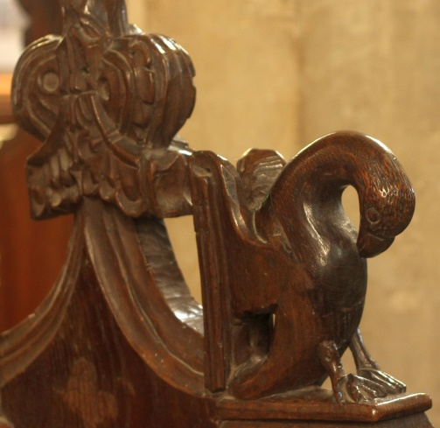
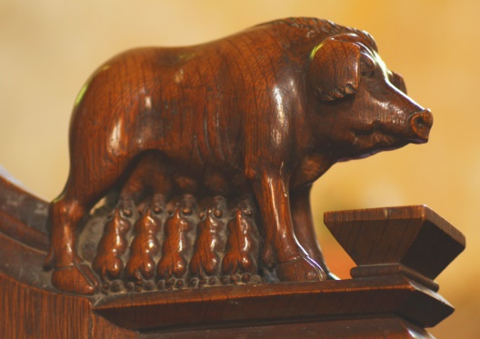
All Saints Church, Beighton
Inside the church:
An interesting 13th century font
Finely carved pews of 1845/6 – look out for a feeding sow, a dog, a pelican, and various Saints
The Reredos with a central panel of cloisonné tiling with the Ten Commandments boards on either side
A restored rood-screen complete with crucifixion scene with four attendant figures above

Slide 4
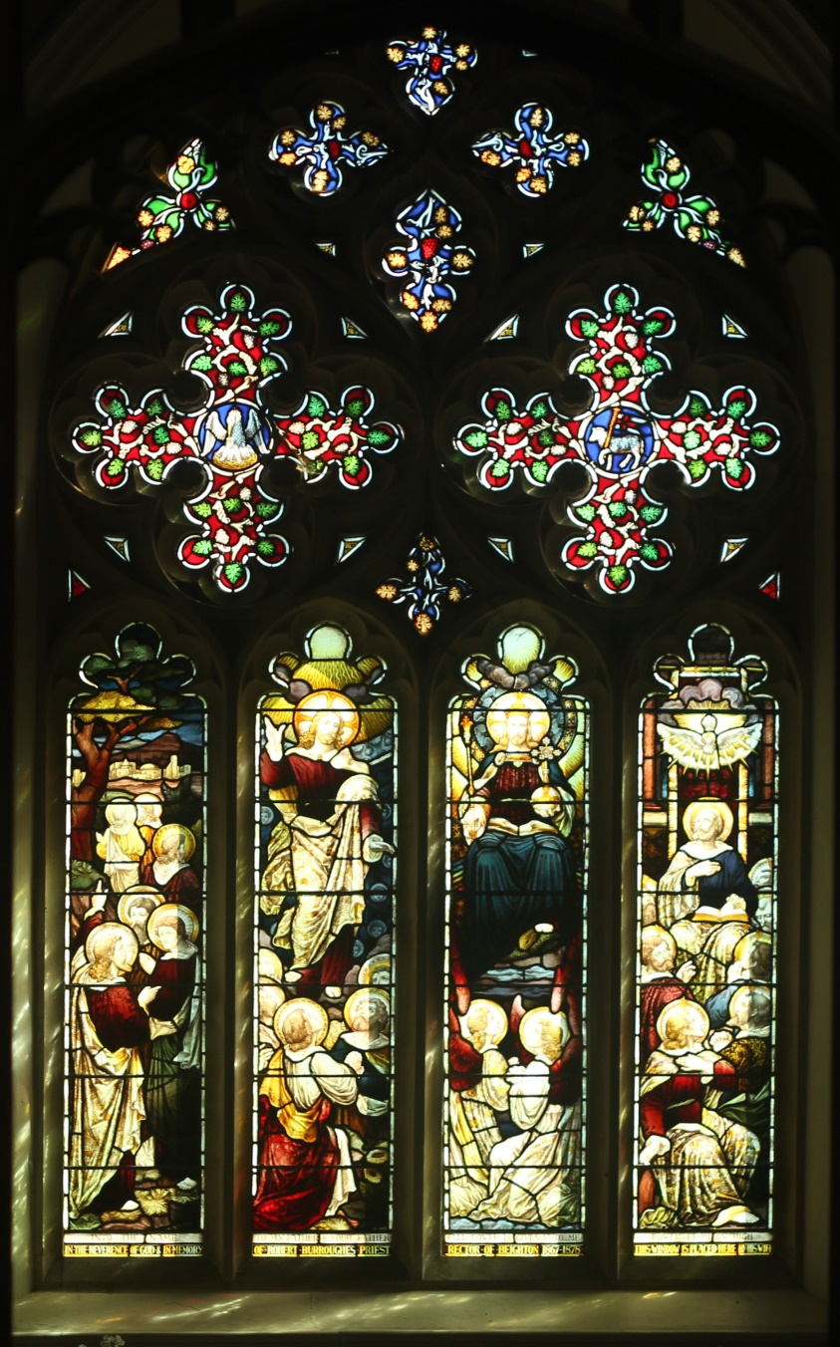
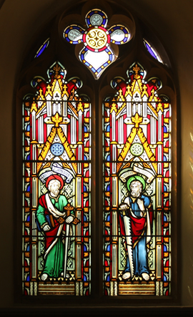
All Saints Church, Beighton
Simon Knott correctly states“The best feature….is the good collection of 19thc glass. The Chancel glows jewel-like and the work of William Warrington is as good as he usually is…. The decorative glass in the North aisle is perhaps the finest of it’s kind in Norfolk”

Slide 5
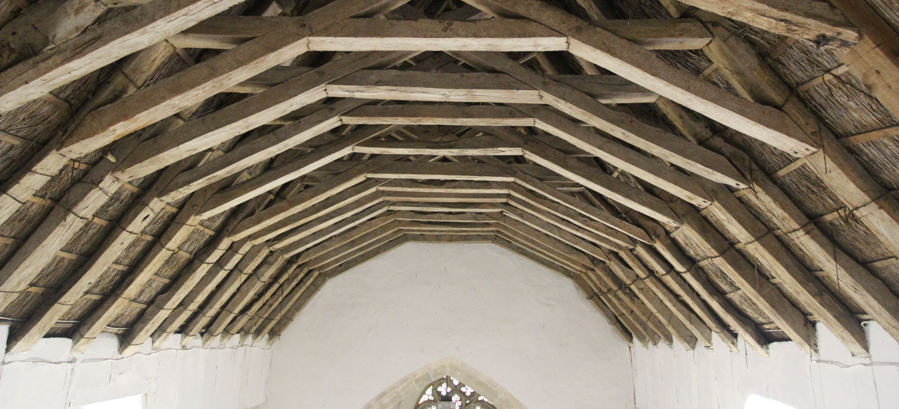
All Saints Church, Beighton
A stunning and historically important 14th century open timber frame roof:
“The roof is constructed with trusses in a scissor brace form, where the braces, traversing the collar beam, intersect each other before being tenoned into the opposite rafters from which they started, creating a pleasing, almost regular, polygonal arch”
(After Raphael and J. Arthur Brandon)

Slide 6
All Saints Church, Beighton
The nave roof is in urgent need of rethatching with some attention being required to repair and restore the supporting trusses.
This pressing requirement has led to a more comprehensive program of work to preserve the building for years to come, and to make it a useful place for its community and visitors alike:
Repair and restore the roof structure and renew the thatch
Repair high level windows and interior walls
Provide a meeting area with galley kitchen facilities
Provide toilet facilities in the vestry
Install mains water

Slide 7
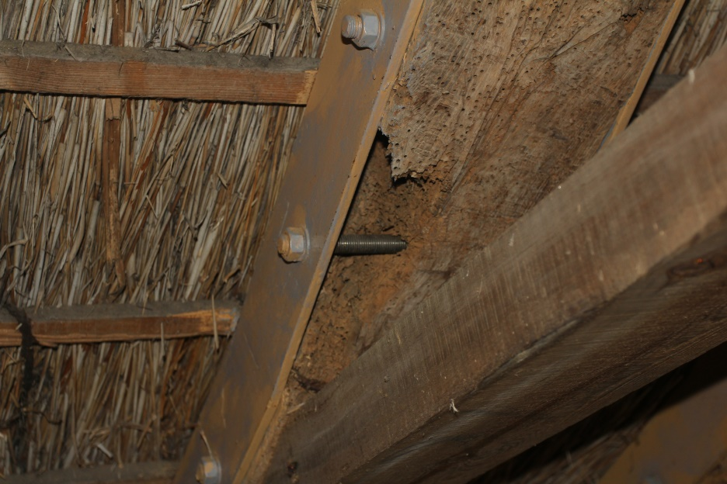
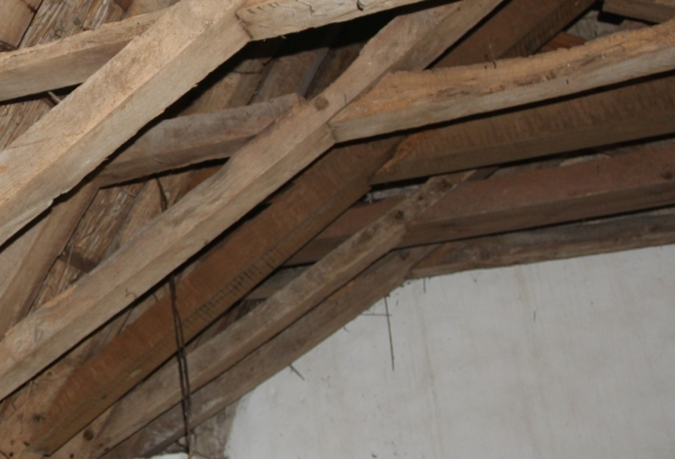
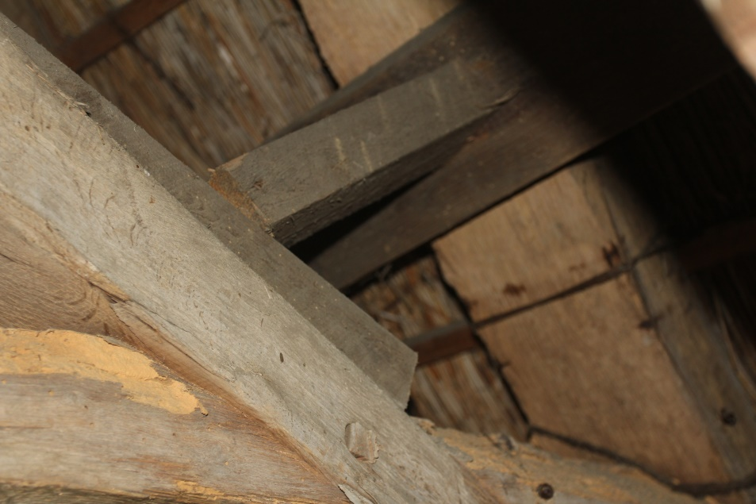
All Saints Church, Beighton
Wood boring insect damage and steel bracing
Some issues with the roof:
Unsympathetic timber replacement
The intention is to retain as much of the original 14th century structural material as possible
Emergency added supports

Slide 8
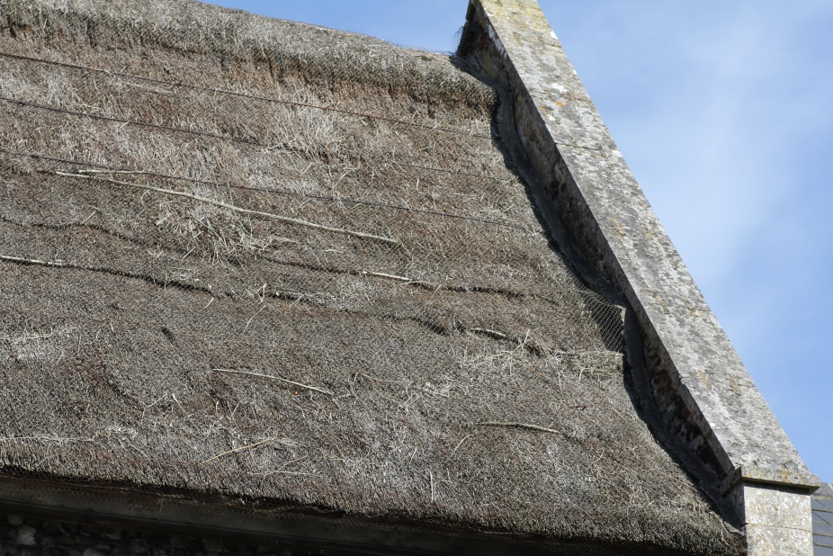
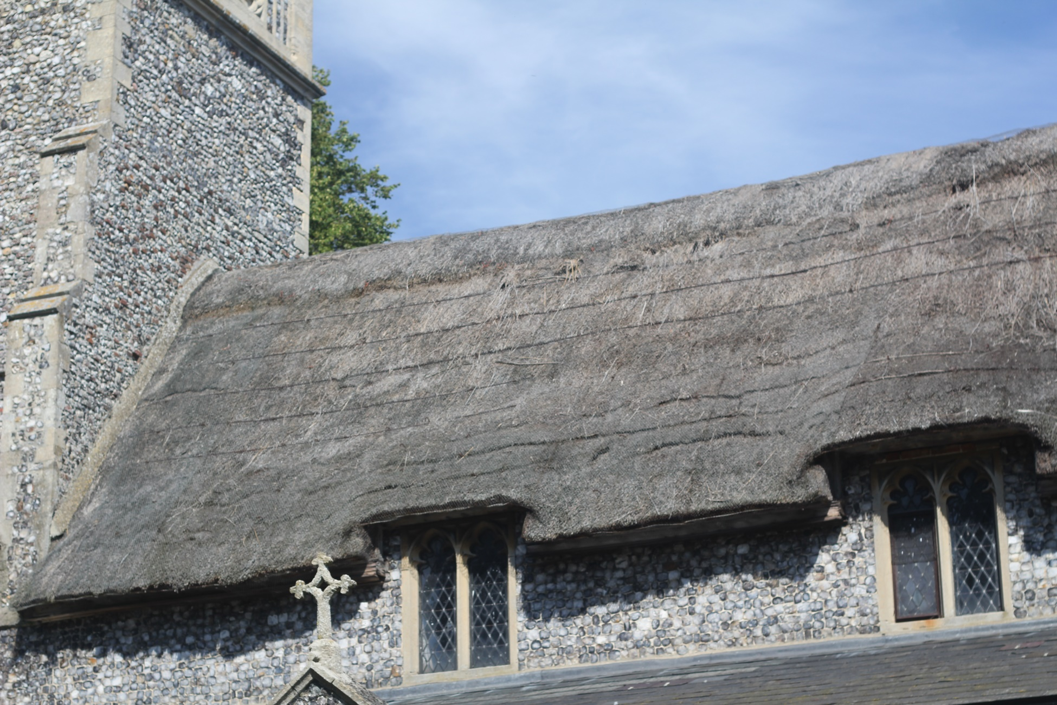
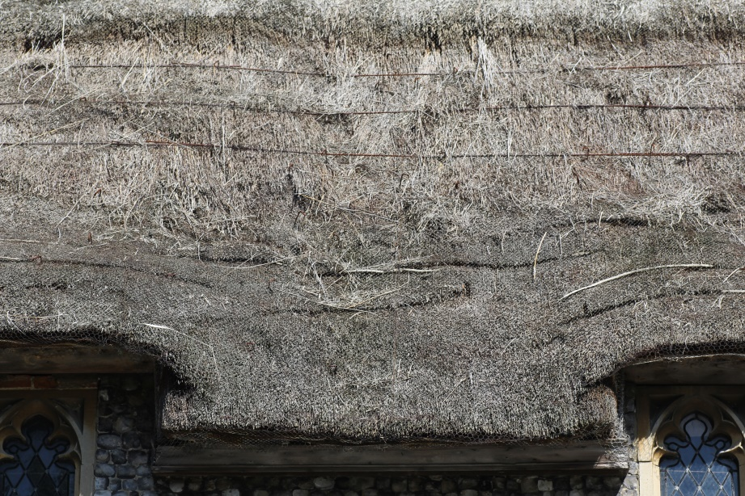
All Saints Church, Beighton
And, of course, the thatch itself:
Basically very old, very weathered, thin, and open to the elements in places

Slide 9
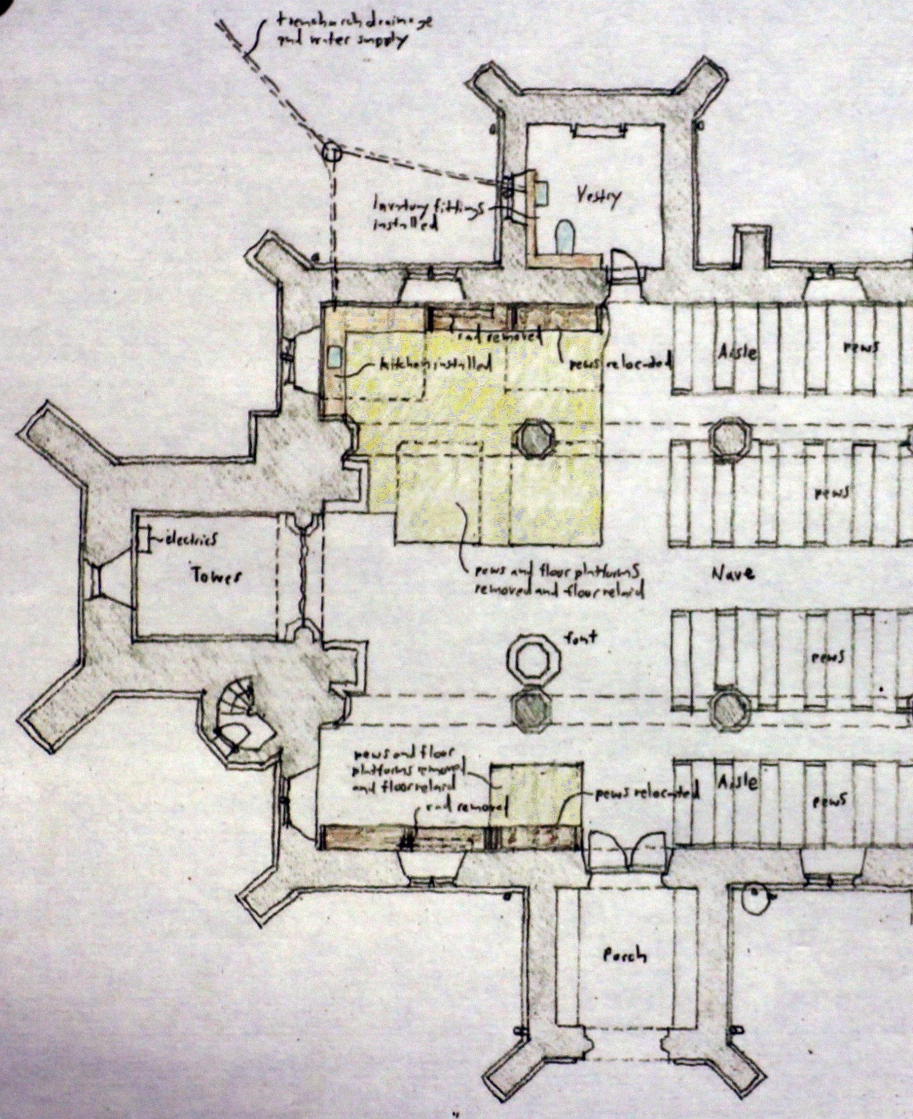
All Saints Church, Beighton
Other development works in the North aisle and Vestry:
New meeting area
Galley kitchen
Toilet in Vestry
Mains water
Pew relocation
Floors relaid

Slide 10
All Saints Church, Beighton
How much will the project cost?
The whole project is estimated at £175,843 in two phases:
Development phase £22,220
Delivery phase £153,623
Most of the funding will come from the Heritage Lottery Fund, with added support from the Central Government Listed Places of Worship Grant Scheme, the County Churches Trust, and the Parochial Church Council.
But through local appeal and donations, and other grant bodies we must find £15,564, of which £1,715 is required now for the Development phase, and £13,949 for the Delivery phase .

Slide 11
All Saints Church, Beighton
Funding details
Income Source | Description | Amount (£)
Development Phase
Heritage Lottery Fund | Grant | 17,000
Central Government | Listed Places of Worship Grant Scheme | 3,200
Parochial Church Council | Fabric Fund | 305
Other Fundraising | Local appeal, donation & other grants | 1,715
Total Development Phase |  | 22,220
Delivery Phase
Heritage Lottery Fund | Grant | 107,500
Central Government | Listed Places of Worship Grant Scheme | 25,164
County Churches Trust | Grant | 5,000
Parochial Church Council | Fabric Fund | 2,010
Other Fundraising | Local appeal, donation & other grants | 13,949
Total Delivery Phase |  | 153,623
 |  | Grand Total | 175,843
Total required from local appeal and donation |  |  | 15,664

Slide 12
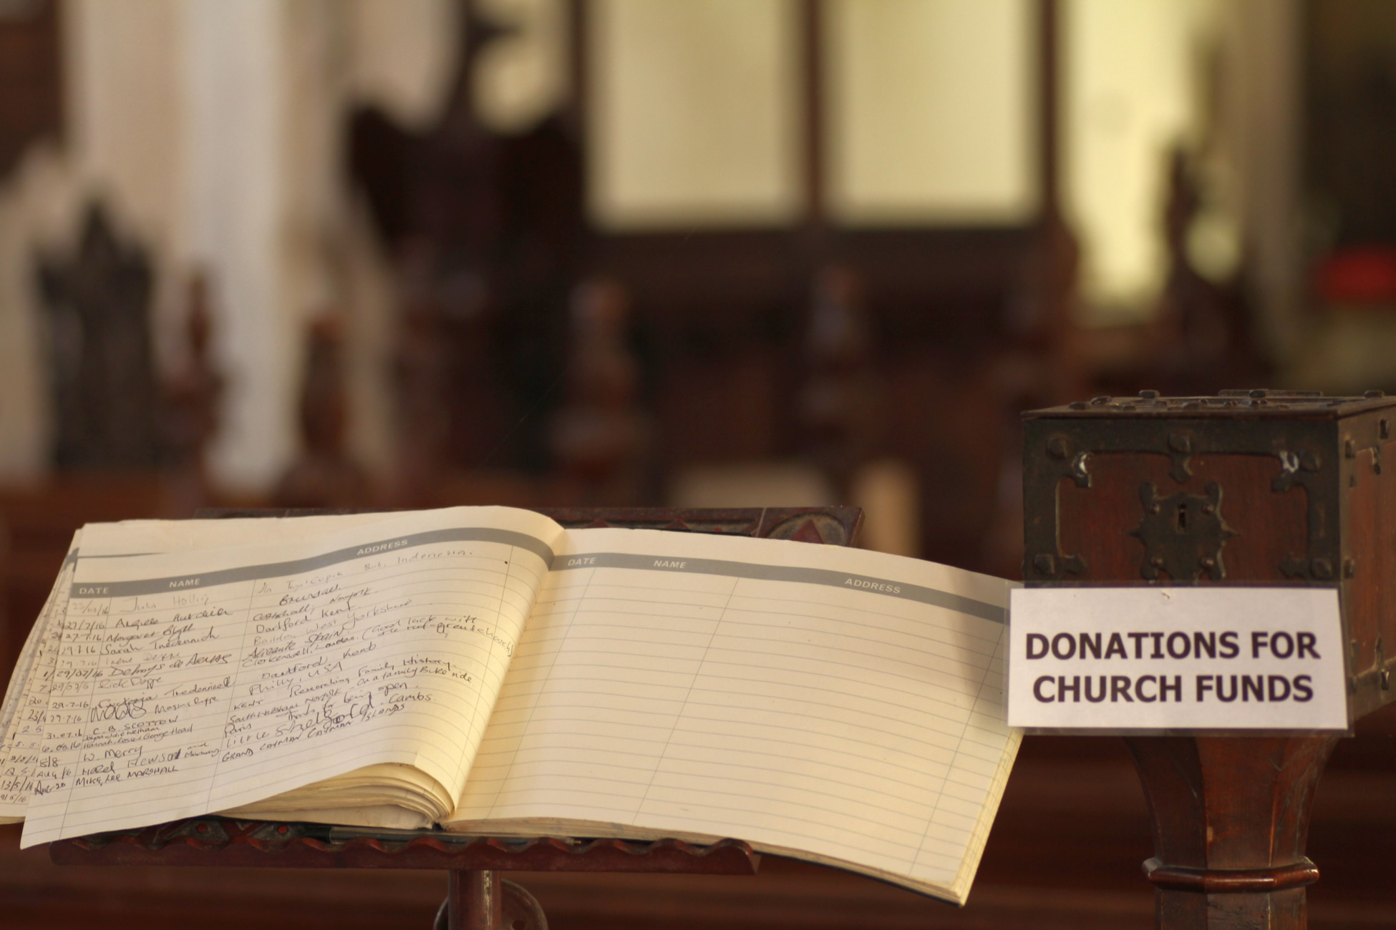
All Saints Church, Beighton
Please bring visitors and give generously!
Appeal
Donations
Thank you!

